Slide 1
UNIT 5
CONCEPT DEVELOPMENT

Slide 2
Task Flow
A task flow is a diagram that represents a user’s journey through a specific task.
Instead of viewing a single piece of content in isolation, a task flow allows you to consider how one piece of content connects to the next. These connections form the paths that users travel to arrive at their endpoint.
Before beginning content planning or creation, you can use task flows to figure out what your users are trying to accomplish. What are their main goals as they navigate your content.
Task flows tend to be linear, showing the high-level steps that a person would take to get to a specific goal or end point.

Slide 3
Task flow analysis
A step-by-step analysis of how a user will interact with a system in order to reach a goal.
This analysis is documented in a diagram that traces a user’s possible paths through sequences of tasks and decision points in pursuit of their goal.
The tasks and decision points should represent steps taken by the user, as well as steps taken by the system.
To validate a design team’s understanding of users’ goals, common scenarios, and tasks, and to illustrate in a solution-agnostic way the overall flow of tasks through which a user progresses to accomplish a goal.
Task flow diagrams also help surface obstacles in the way of users achieving their goal.

Slide 4
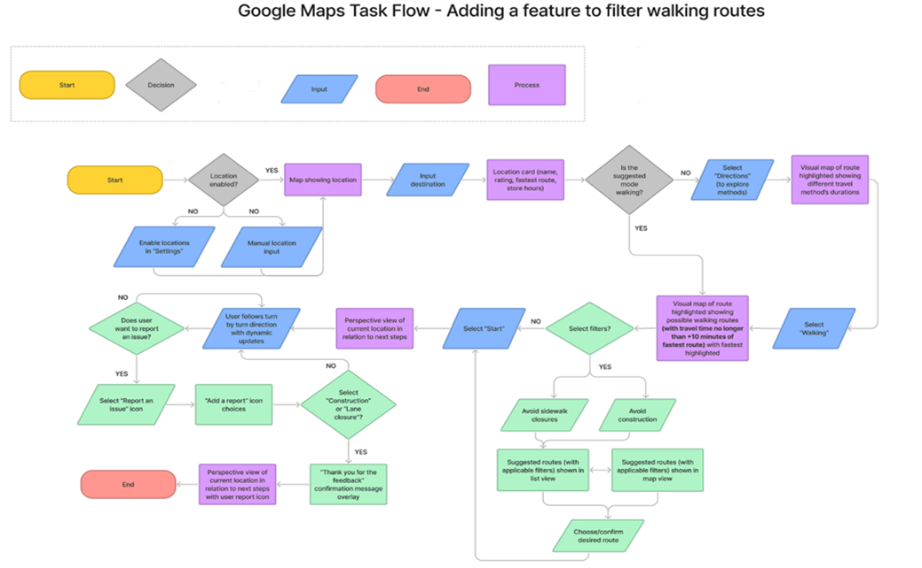

Slide 5
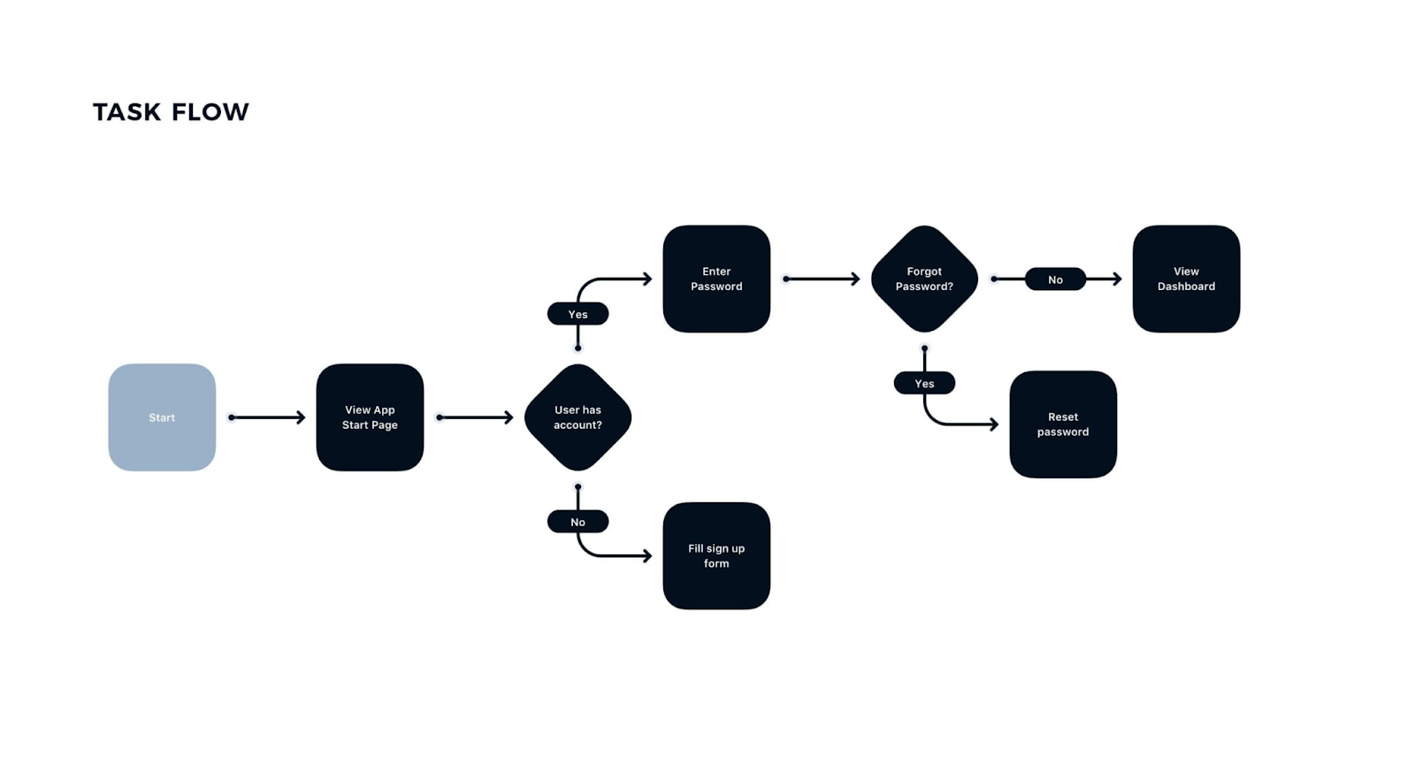

Slide 6
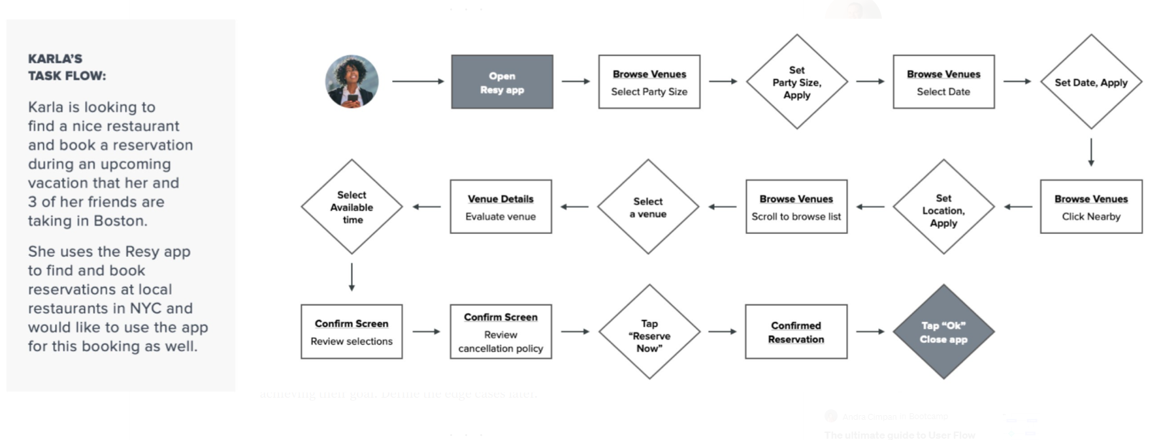
Task flow :

Slide 7
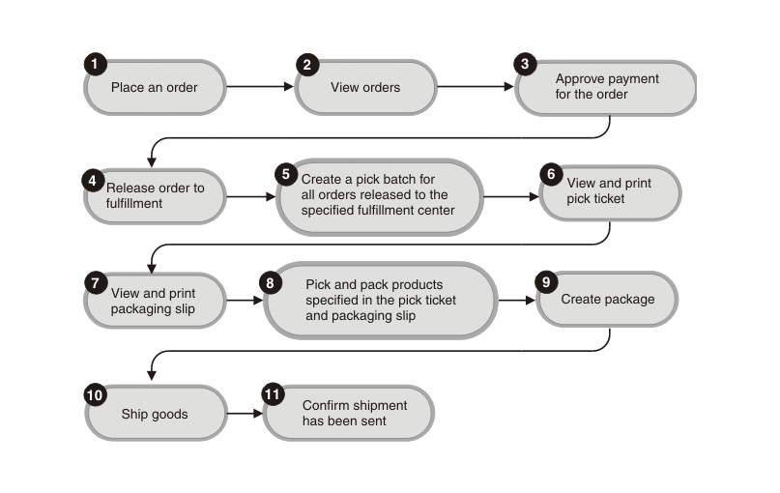
Task flow for Order Management

Slide 8
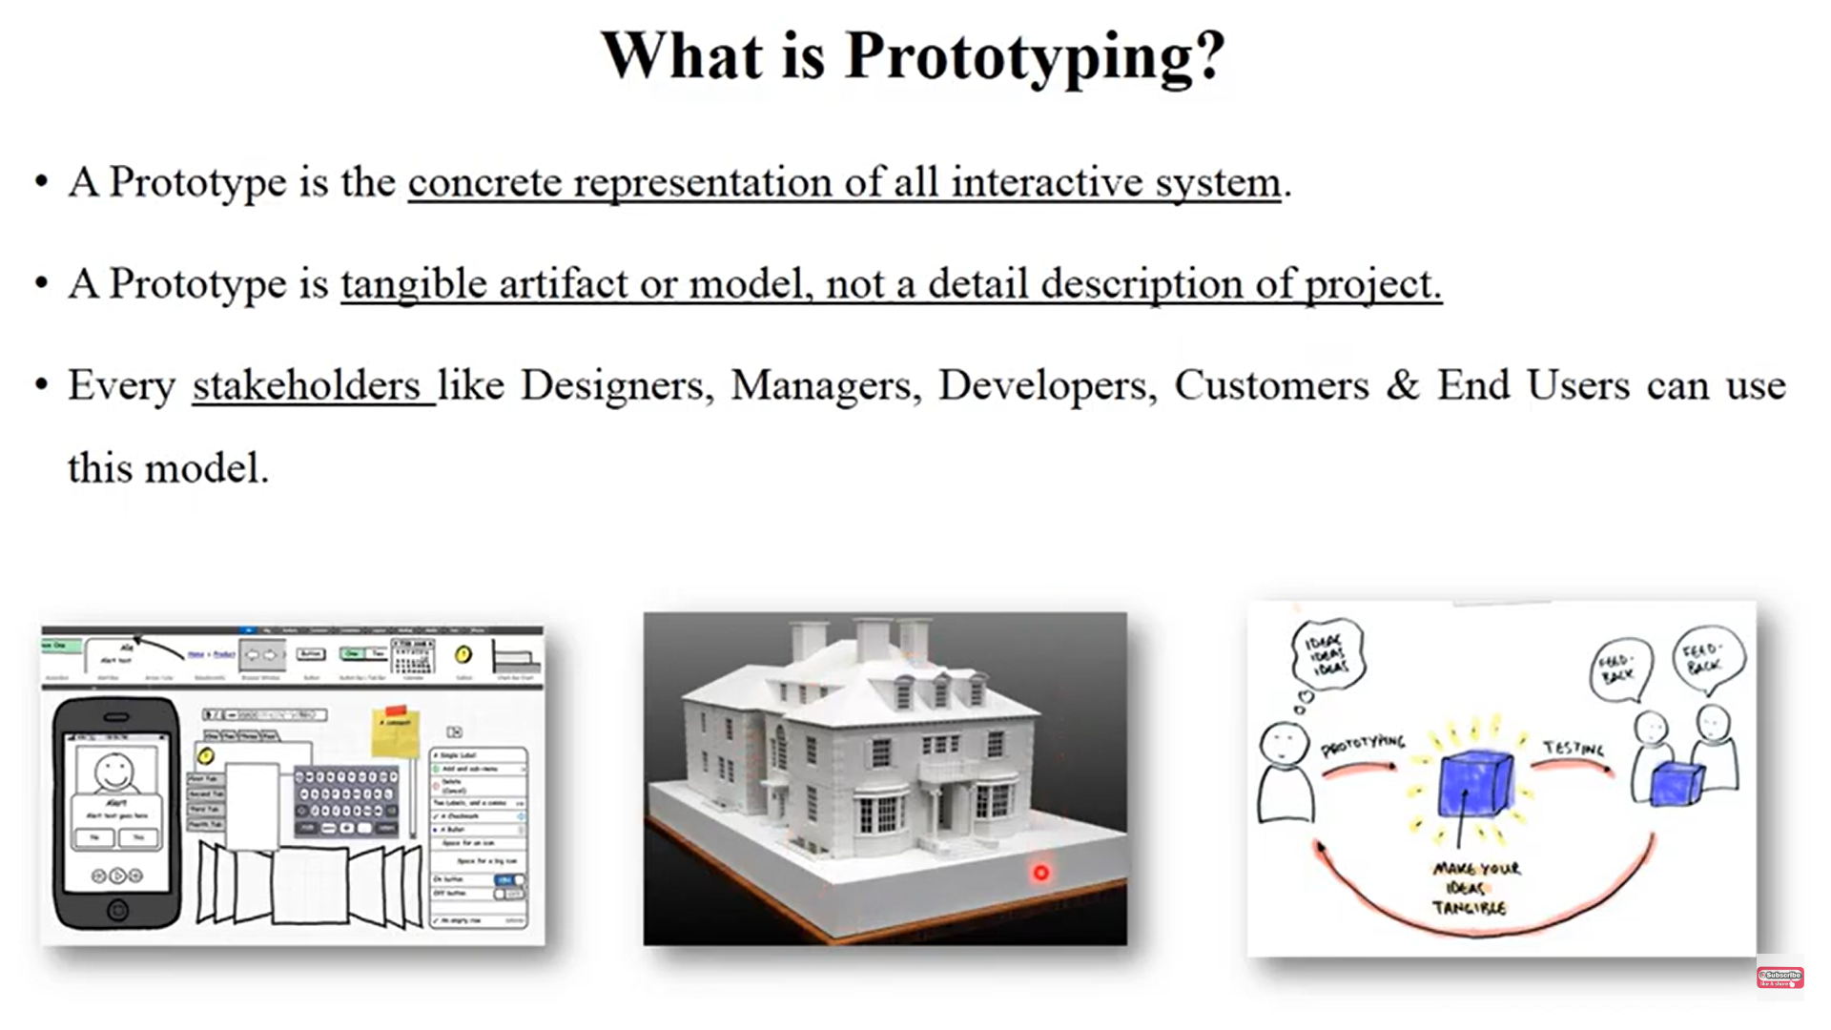

Slide 9
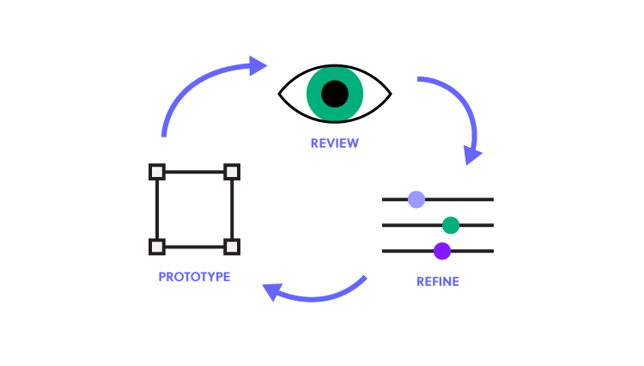
Prototype
A prototype is “A simulation or sample version of a final product, which UX teams use for testing before launch.”
The goal of a prototype is to test and validate ideas before sharing them with stakeholders and eventually passing the final designs to engineering teams for the development process.
Prototypes are essential for identifying and solving user pain points with participants during usability testing.
Testing prototypes with end-users enables UX teams to visualize and optimize the user experience during the design process.

Slide 10
Prototypes have four main qualities:
Representation — The prototype itself, i.e., paper ,model, HTML and desktop application.
Precision — The fidelity of the prototype, meaning its level of detail—low-fidelity or high-fidelity.
Interactivity — The functionality open to the user, e.g., fully functional, partially functional, or view-only.
Evolution — The lifecycle of the prototype. Some are built quickly, tested, thrown away, and then replaced with an improved version (known as “rapid prototyping”). Others may be created and improved upon, ultimately evolving into the final product.

Slide 11
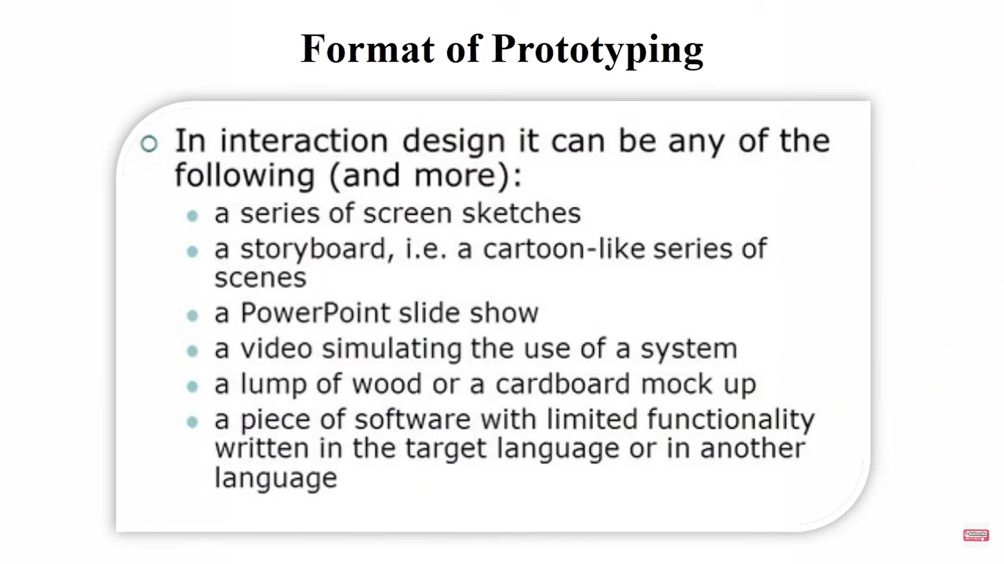

Slide 12
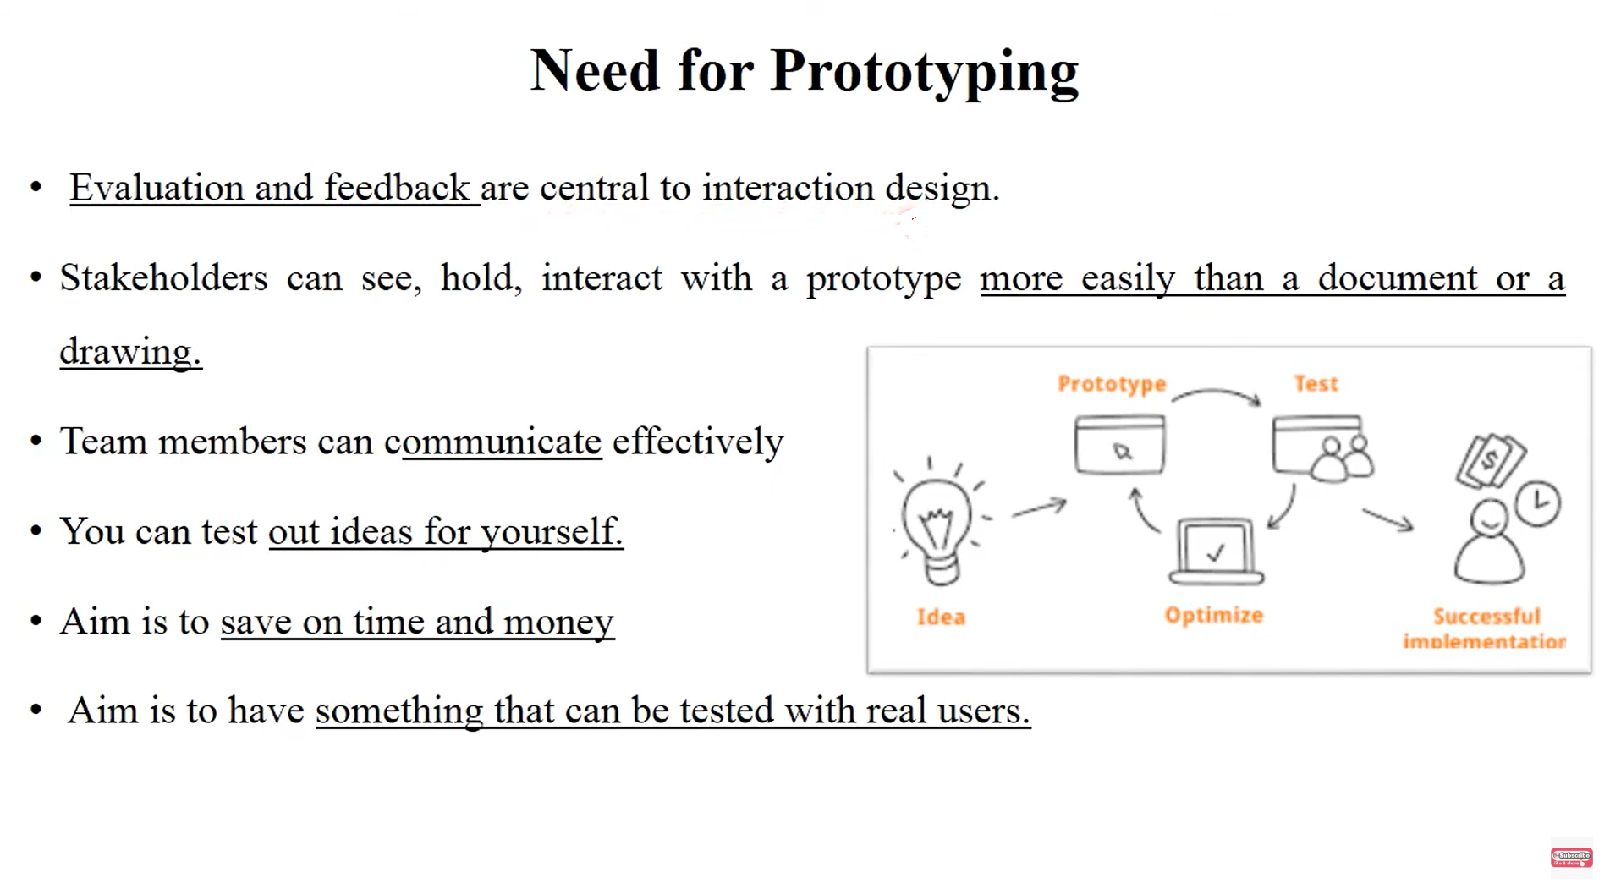
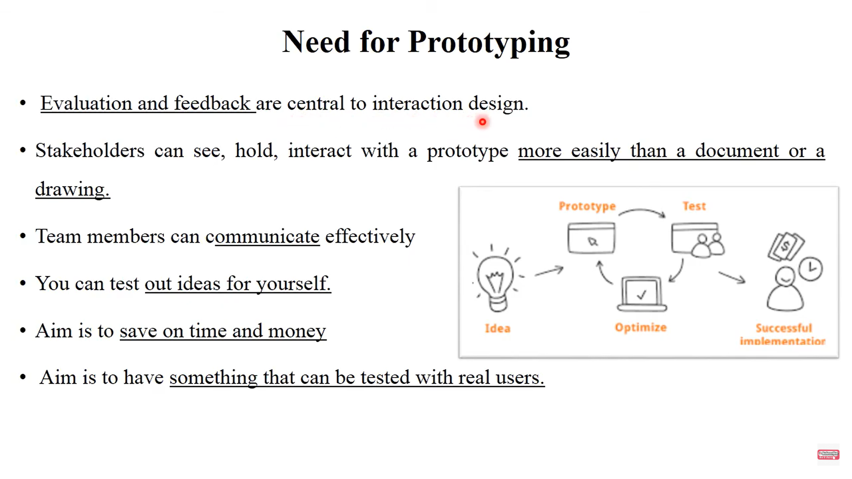

Slide 13
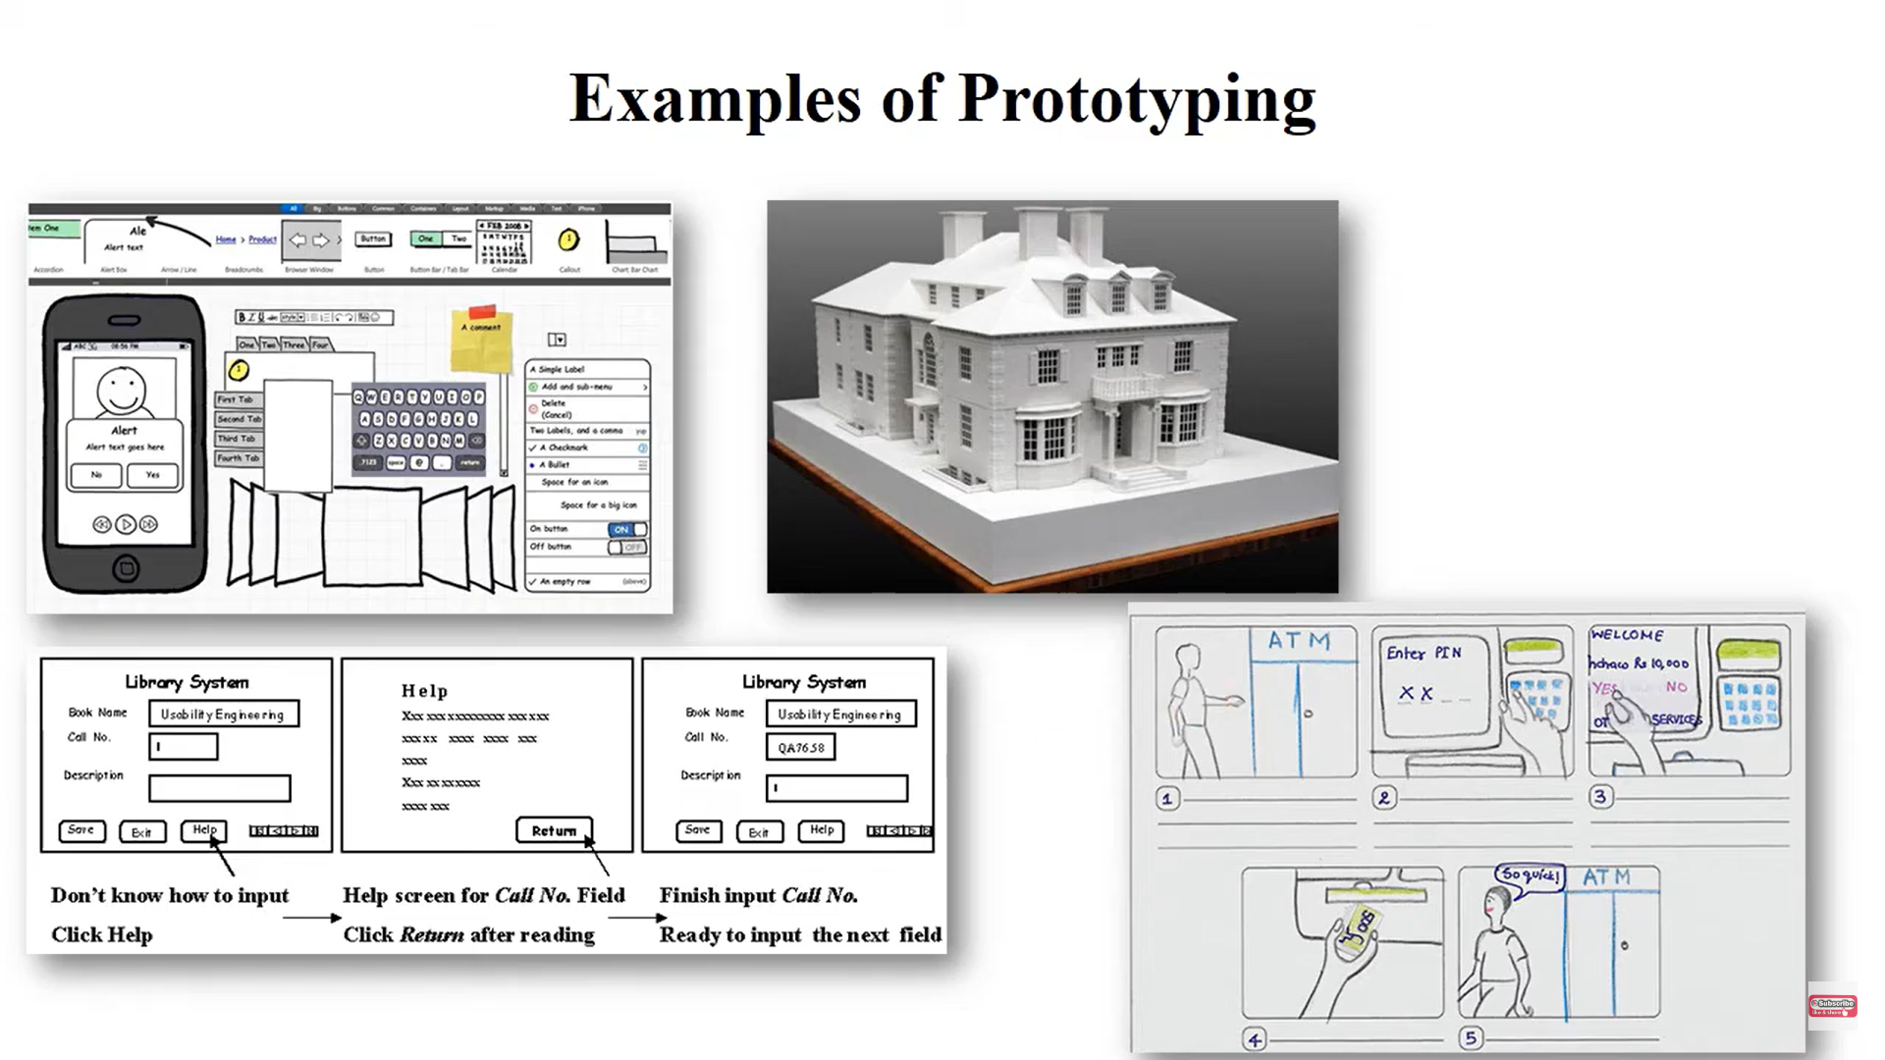

Slide 14
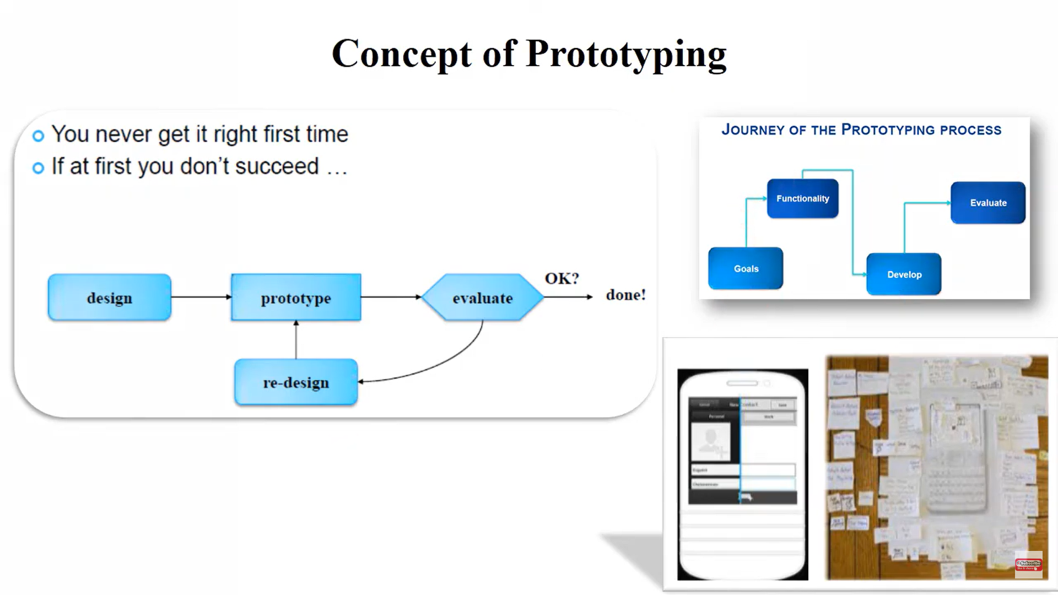

Slide 15
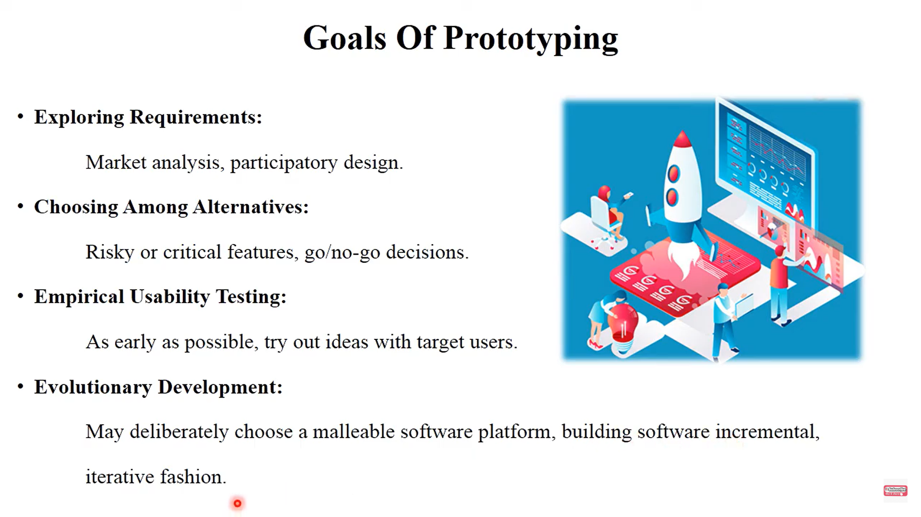

Slide 16
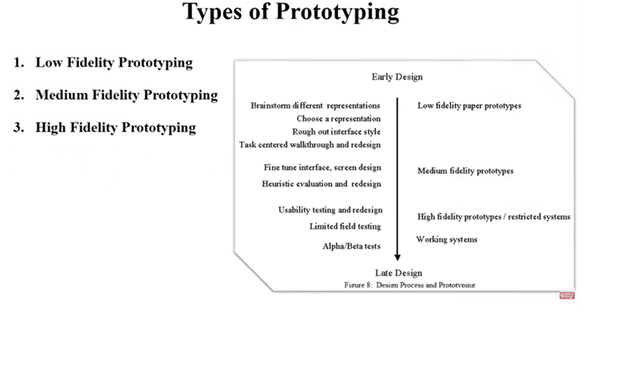

Slide 17
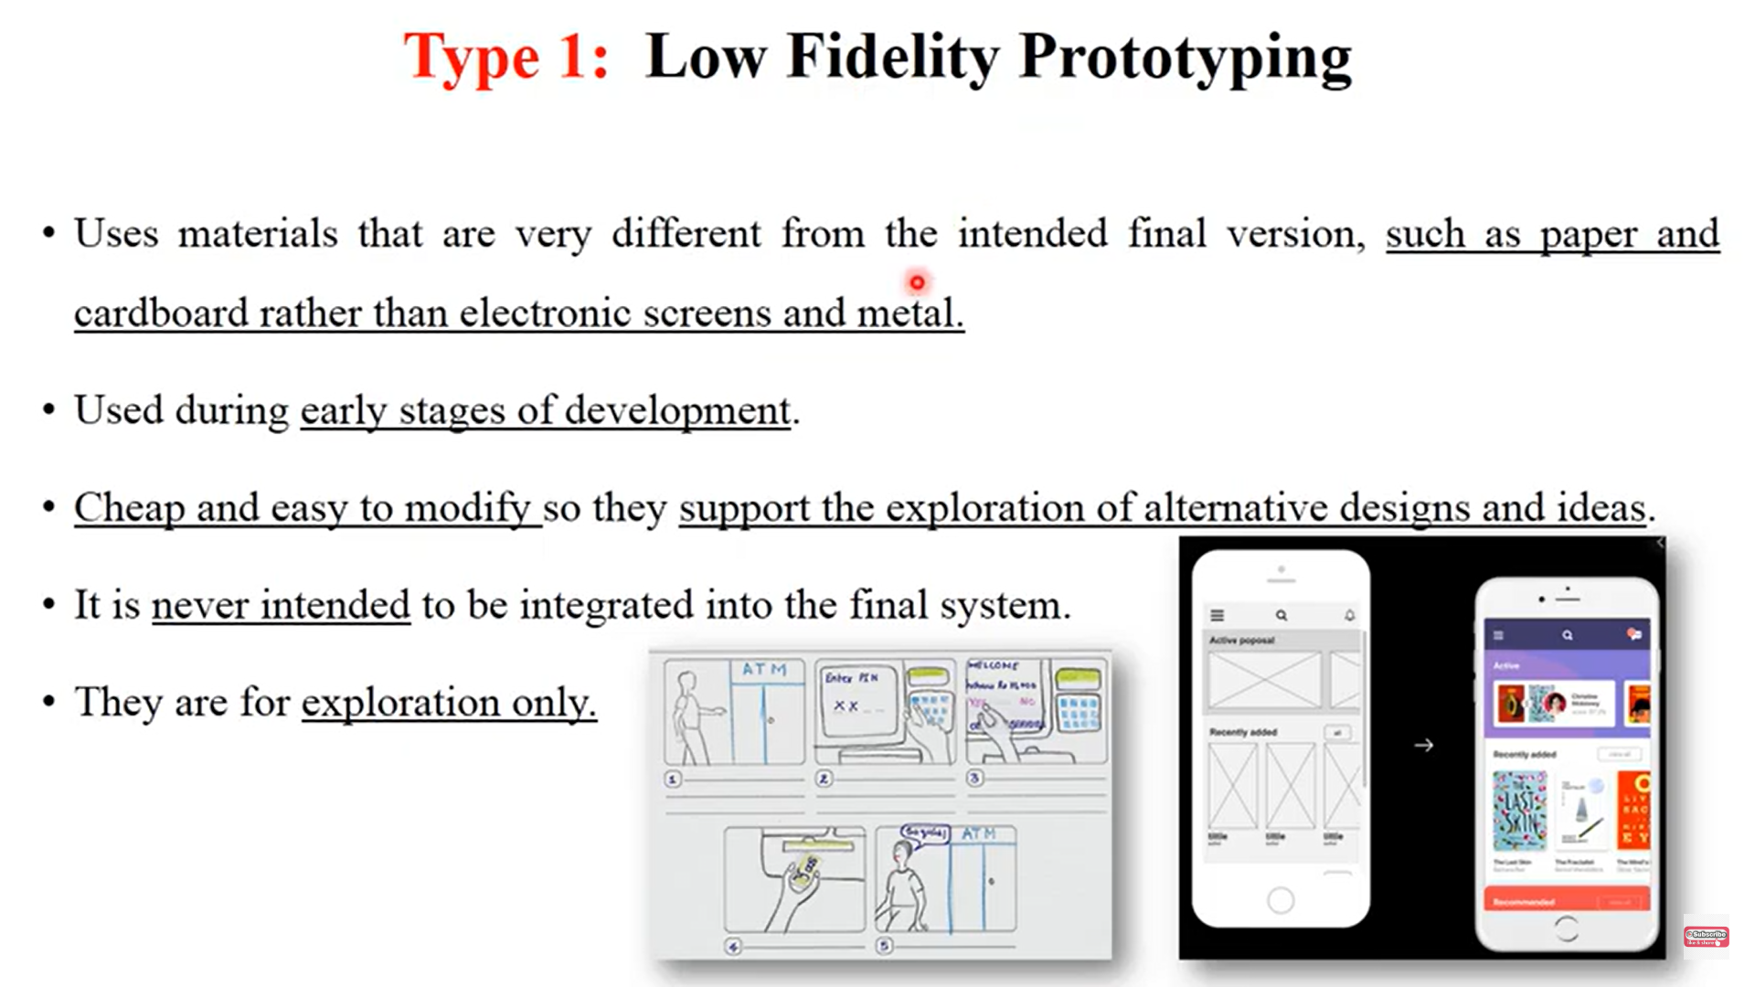

Slide 18
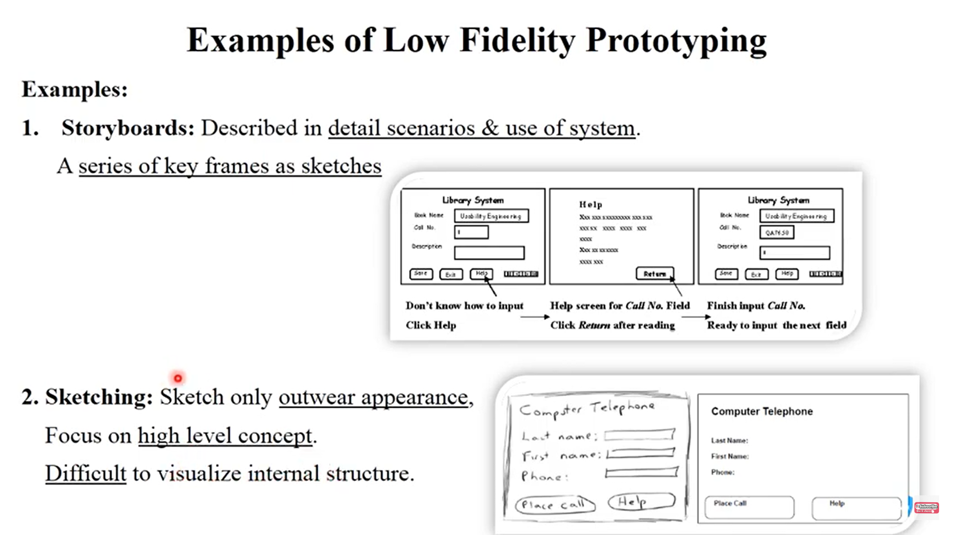

Slide 19
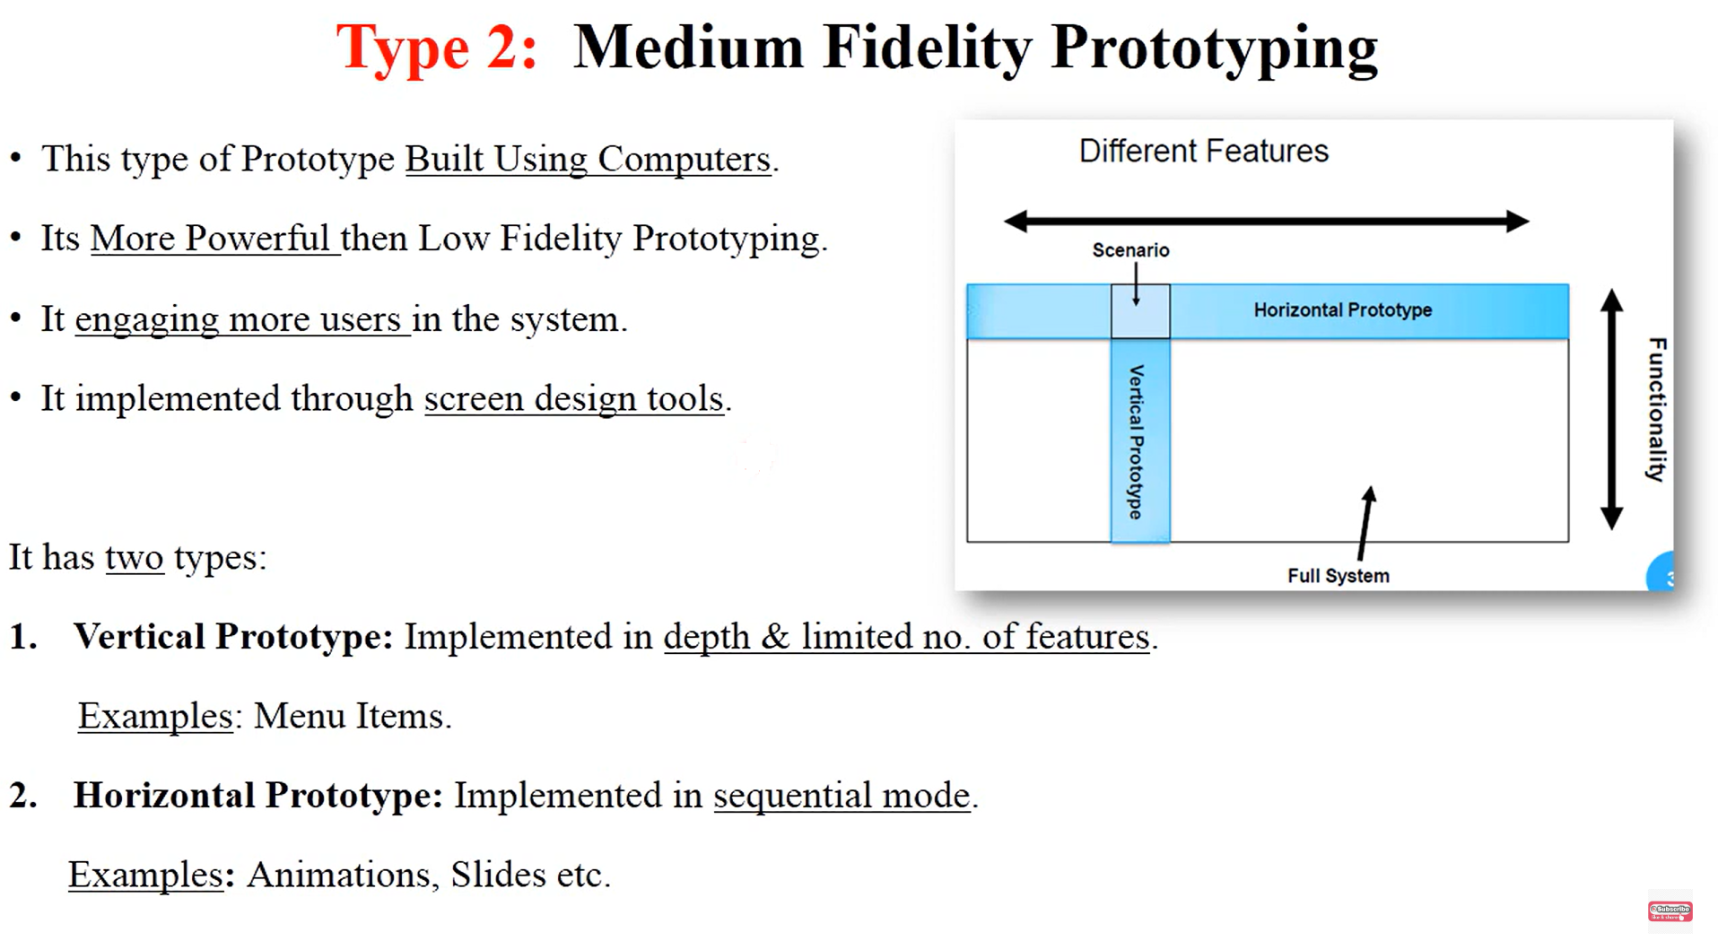

Slide 20
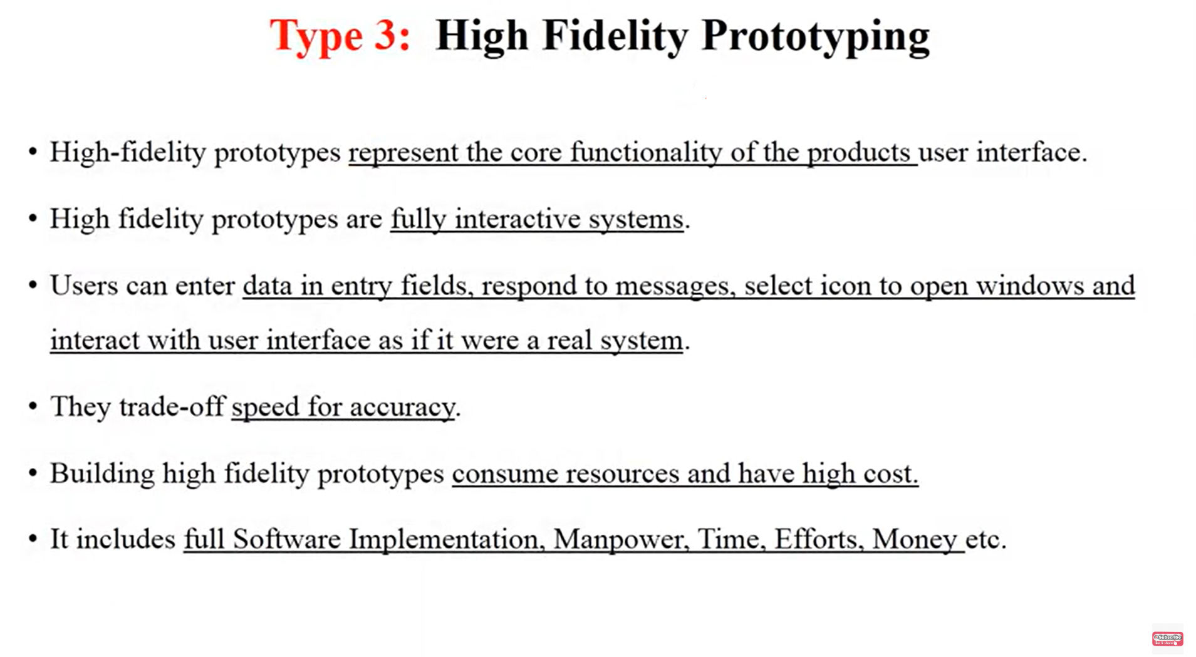

Slide 21
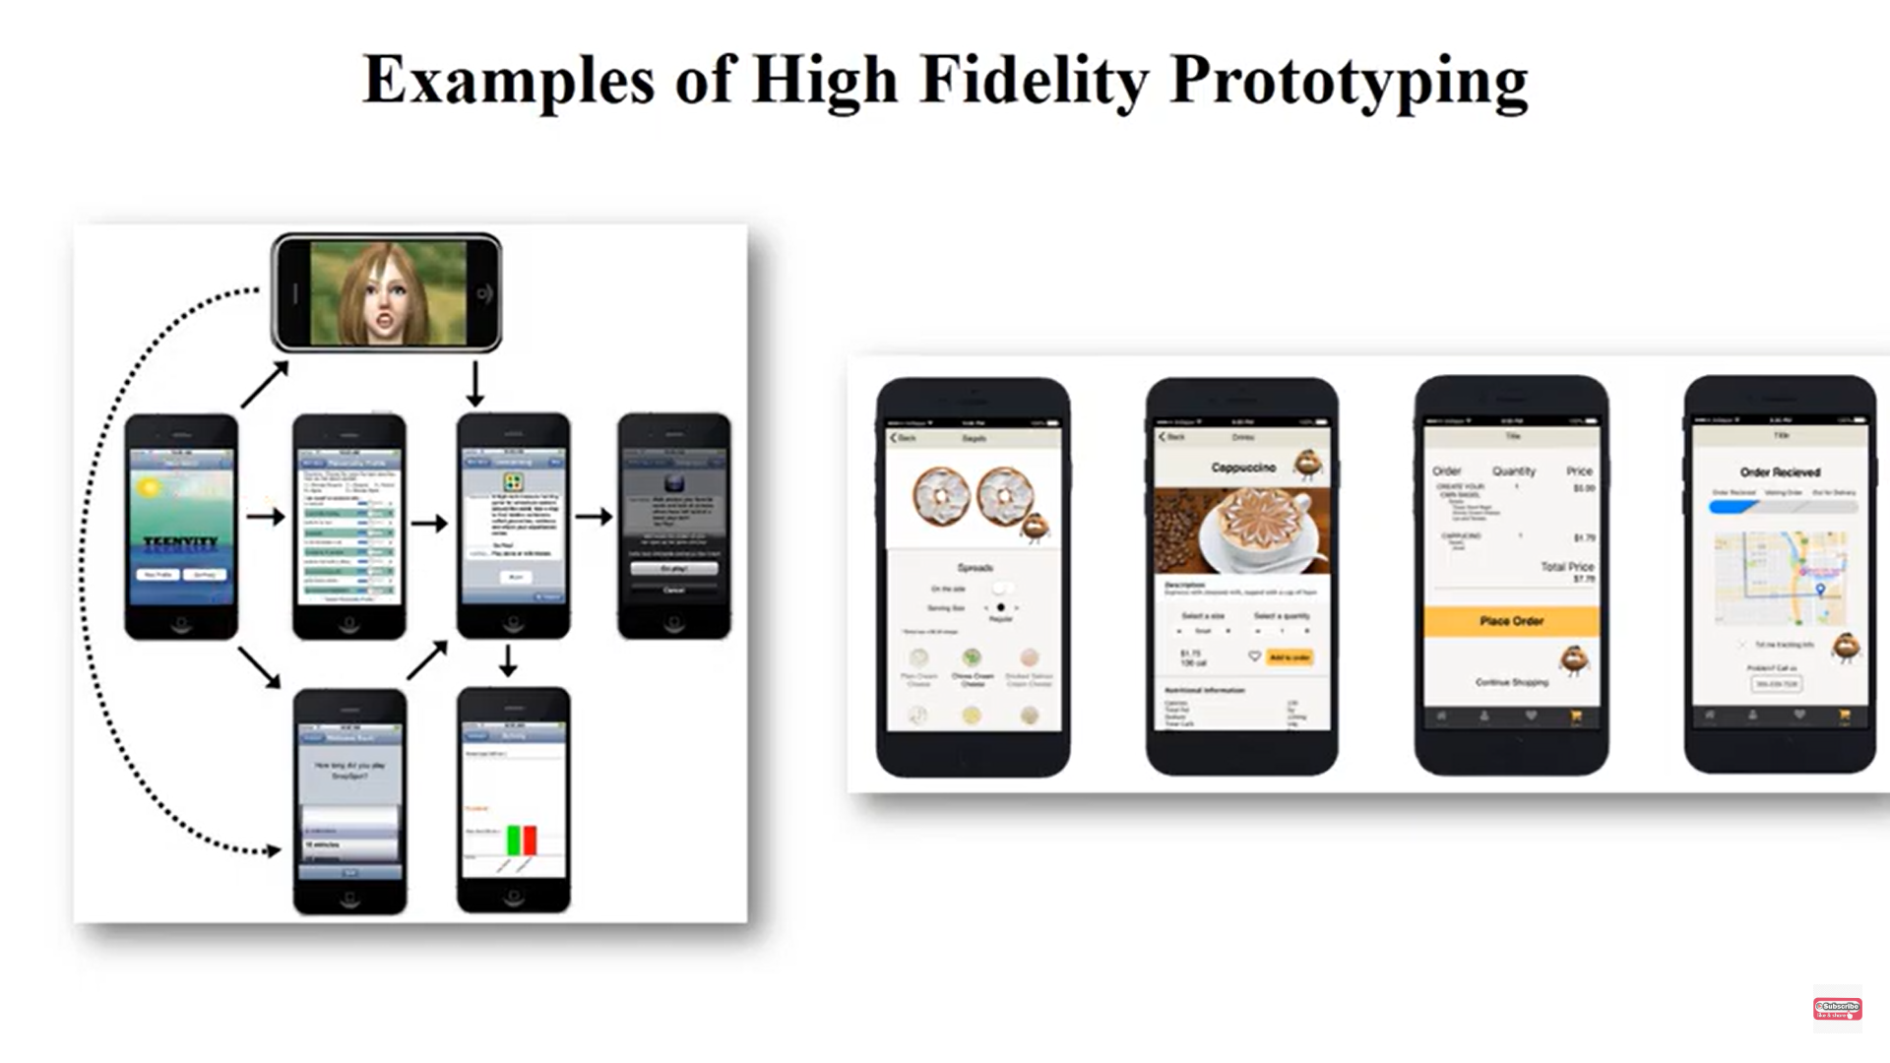

Slide 22
